Slide 1

EV Analytics Dashboard Using Power BI
Batch 484
G. Uttej Reddy
M. Kishore Reddy

Slide 2
About me
G. Uttej Reddy
Pursuing B.Tech (IT) at Anurag University
Interested in Data Analytics to analyze data, solve real-world problems, and make smart decisions using technology
LinkedIn: www.linkedin.com/in/gangireddy-uttej-reddy-12376029b
GitHub: https://github.com/Gangireddy-uttej-reddy
M. Kishore Reddy
Pursuing B.Tech (IT) at Anurag University
Interested in Data Analytics because it combines programming, analytics, and business insights to create impactful solutions
LinkedIn: http://www.linkedin.com/in/mandadi-kishore-reddy-bb243a287
GitHub: https://github.com/kishore-345

Slide 3
Agenda
Business Problem
Problem Statement
Objective
DashBoard
Conclusion
Recommendation
Thank you

Slide 4
Business Problem
The global adoption of Electric Vehicles (EVs) is increasing rapidly, generating large volumes of data related to EV sales, stock, energy consumption, powertrains, transport modes, and regional performance. However, analyzing this data manually is difficult and time-consuming due to the complexity and diversity of the information.
Organizations, policymakers, and analysts need an efficient way to monitor EV growth trends, compare regional adoption patterns, understand powertrain performance, and identify key market insights. Without a centralized analytics system, it becomes challenging to make data-driven decisions and track the progress of EV adoption effectively.
To address this challenge, an interactive Power BI dashboard was developed to transform raw EV data into meaningful visual insights through trend analysis, comparative analysis, KPI tracking, and dynamic visualizations.

Slide 5
Problem Statement
The increasing growth of Electric Vehicle (EV) data across multiple regions, categories, and powertrain types has made it difficult to analyze trends and extract meaningful insights using traditional methods. The raw dataset contains complex information related to EV sales, stock, registrations, energy consumption, and transport modes, which requires proper cleaning, transformation, and visualization.
The main problem is to build an interactive and visually effective Power BI dashboard that can analyze EV growth trends, compare regional and powertrain performance, monitor category-wise adoption, and provide time-series insights for better understanding and decision-making.

Slide 6
Objective
• To analyze global Electric Vehicle (EV) growth trends over time
• To compare EV adoption across different regions and categories
• To study the distribution and growth of different powertrain types such as BEV, PHEV, and FCEV
• To analyze EV sales, stock, registrations, and energy consumption patterns
• To perform time-series and comparative analysis using interactive visualizations
• To create calculated columns and measures using DAX for better insights
• To build an interactive and visually appealing dashboard using Power BI
• To generate meaningful insights that support data-driven decision-making

Slide 7
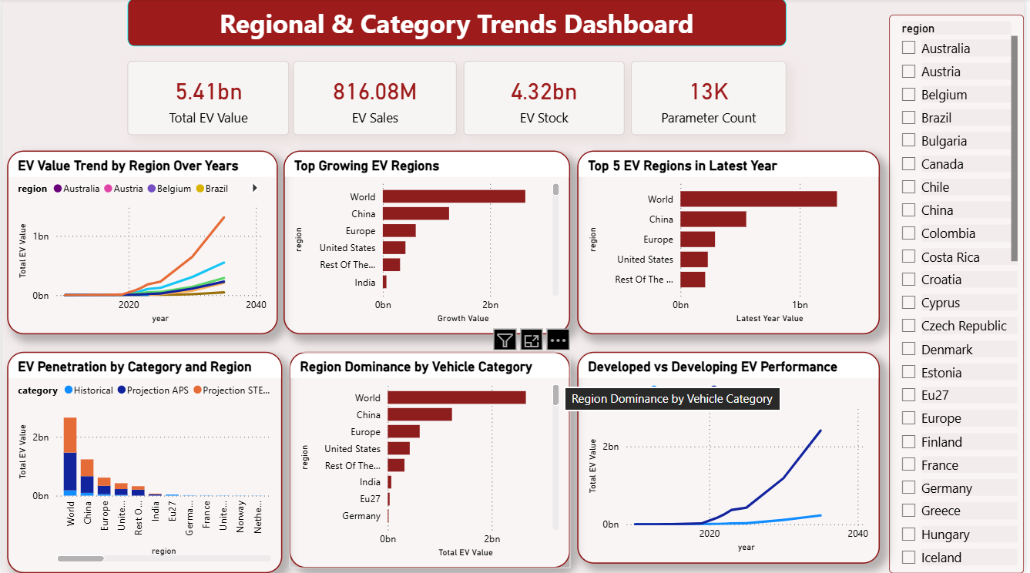
Dashboard

Slide 8
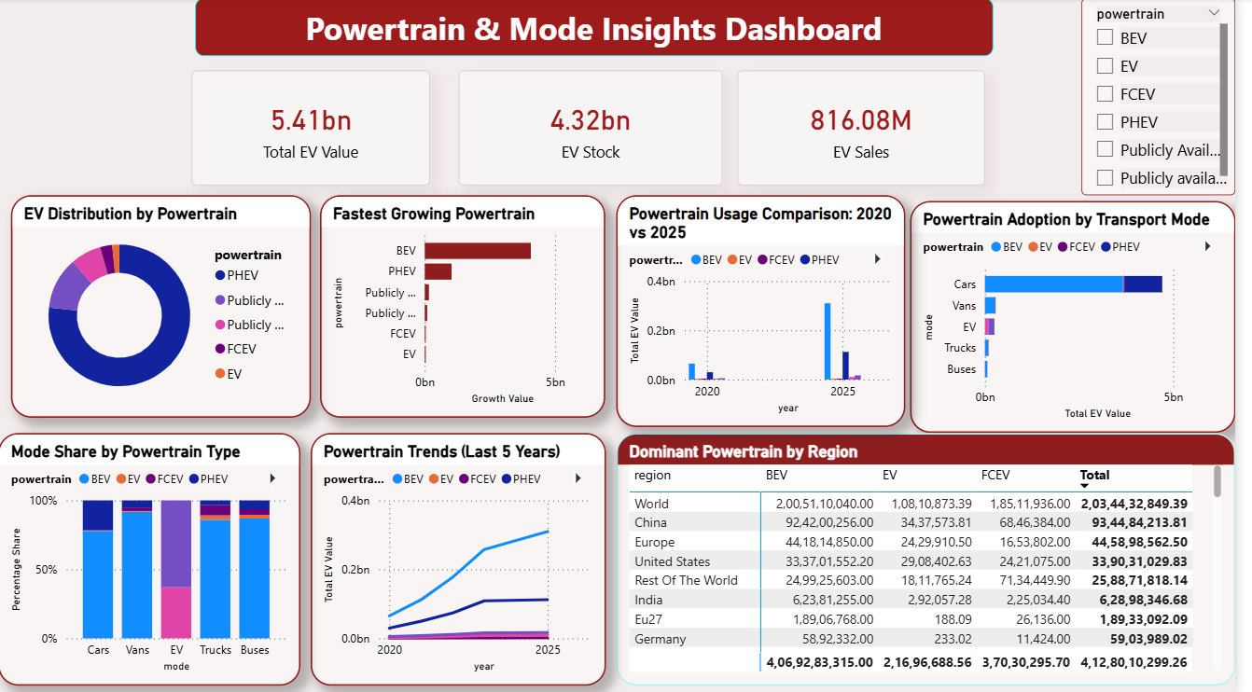
Dashboard

Slide 9
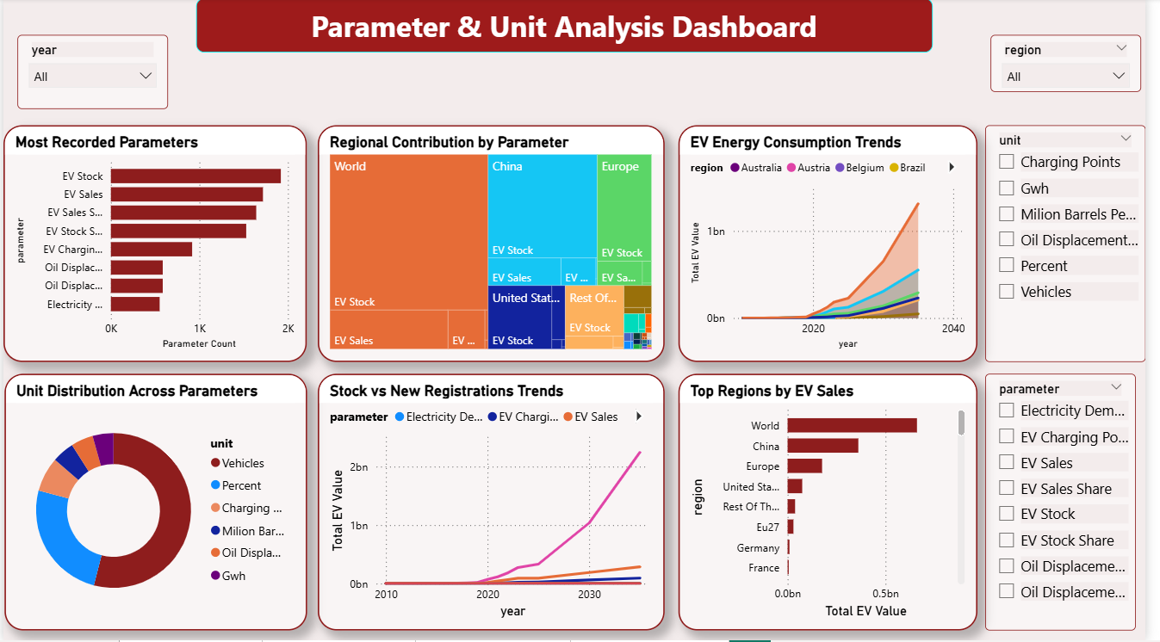
Dashboard

Slide 10
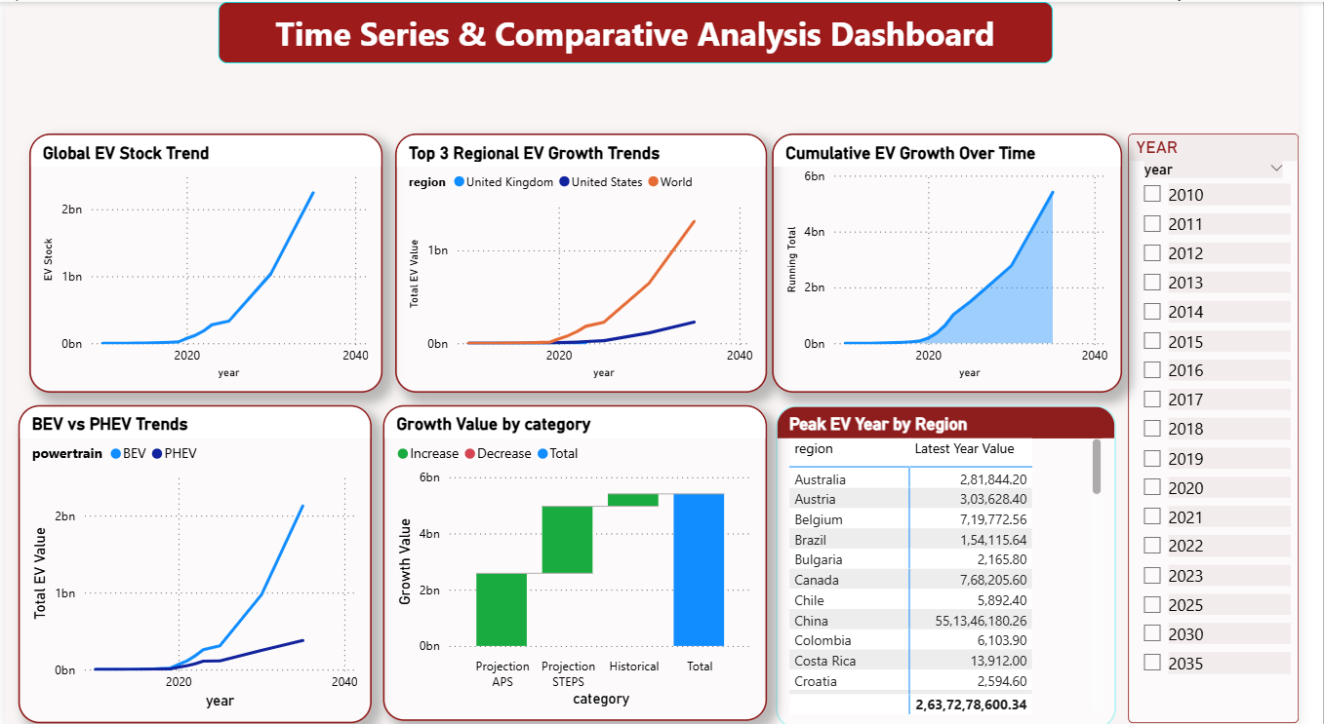
Dashboard

Slide 11
Conclusion
• Successfully built an interactive EV Analytics Dashboard using Power BI
• Analyzed EV growth trends across different years and regions
• Compared EV adoption by categories, powertrains, and transport modes
• Performed data cleaning and transformation for accurate analysis
• Created DAX measures and calculated columns for advanced insights
• Visualized sales, stock, energy consumption, and registrations effectively
• Developed multiple dashboard pages for regional, powertrain, parameter, and time-series analysis
• Generated meaningful insights to support data-driven decision-making
• Improved understanding of Power BI dashboard design and business analytics concepts

Slide 12
Recommendations
• Focus on expanding EV infrastructure in regions showing high growth potential
• Encourage the adoption of dominant powertrain technologies such as BEVs through policy support
• Improve charging station availability to support increasing EV demand
• Monitor regional EV sales and stock trends regularly for better planning and forecasting
• Promote sustainable transport policies to accelerate EV adoption globally
• Use real-time data integration for more accurate and dynamic dashboard insights
• Enhance future dashboards with predictive analytics and forecasting models
• Continuously track energy consumption and environmental impact metrics for sustainable development
• Utilize interactive dashboards for faster business analysis and strategic decision-making

Slide 13

THANK YOU

